Slide 1
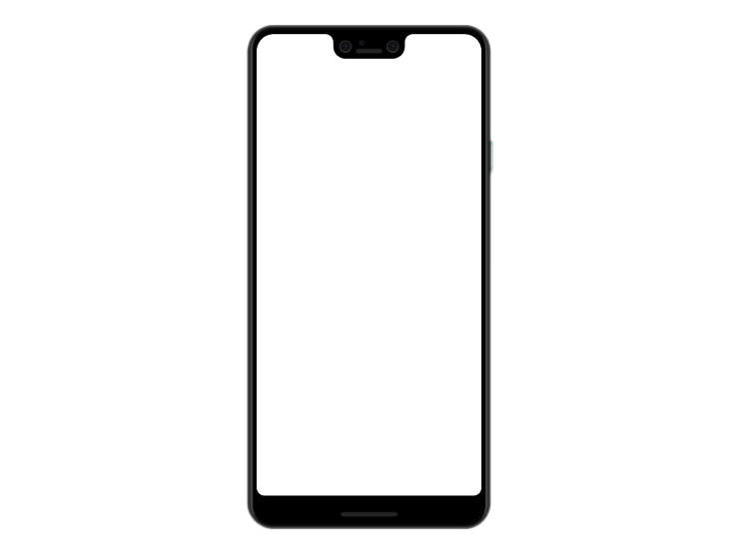
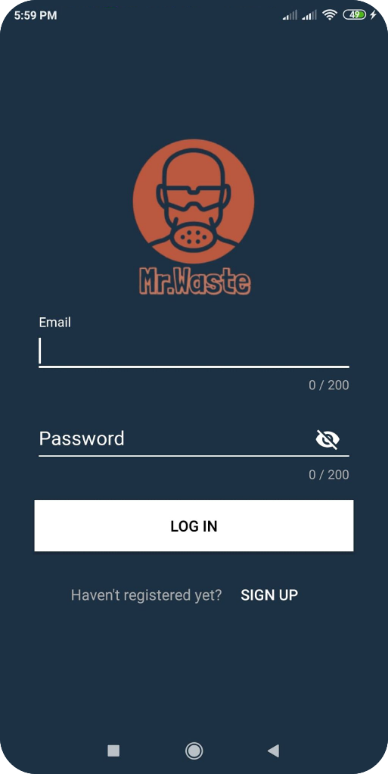
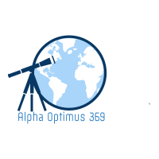
Alpha Optimus 369
with
A New Perspective
Space Apps COVID-19 Challenge

Slide 2


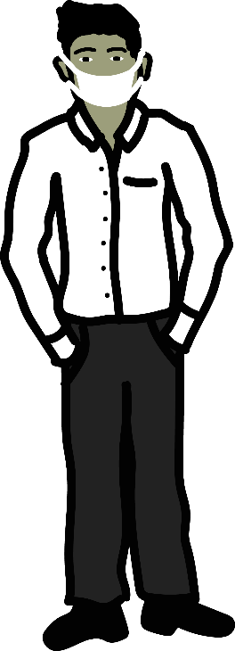




Problem
There are about 170 million people in Bangladesh. Almost 100 million people use masks, gloves, hand sanitizer for their safety. After using these, where all these materials are going
Covid-19
Total cases(Worldwide): 5,817,385
Total cases(Bangladesh): 42 844
Pollute the environment

Slide 3

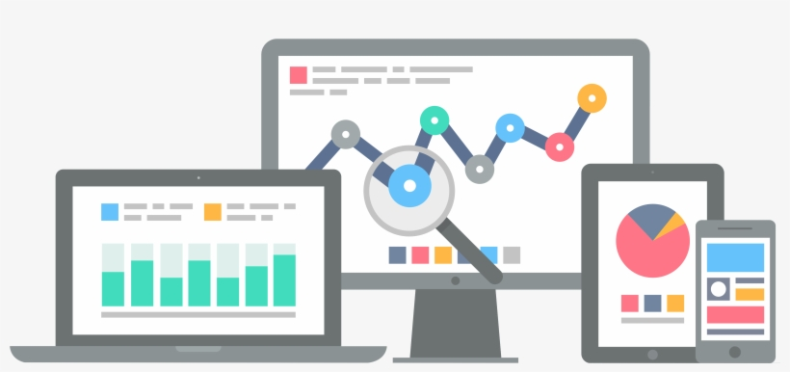


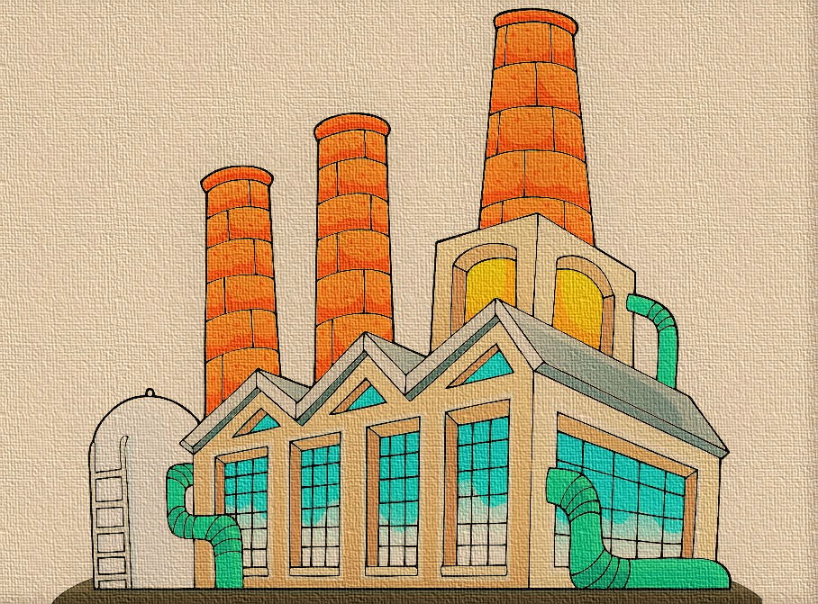



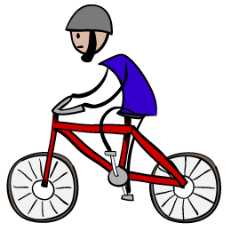
Waste Management Company
1
Decentralized Server
This old man does not know what to do with used mask
2
The lower income person
Getting all these, he goes to provide the waste to the waste management company and take the money for waste
His grandson called “MR. Waste” to utilize the waste and earn some money
4
3
Get notification from the user and reach there to collect the waste

Slide 4

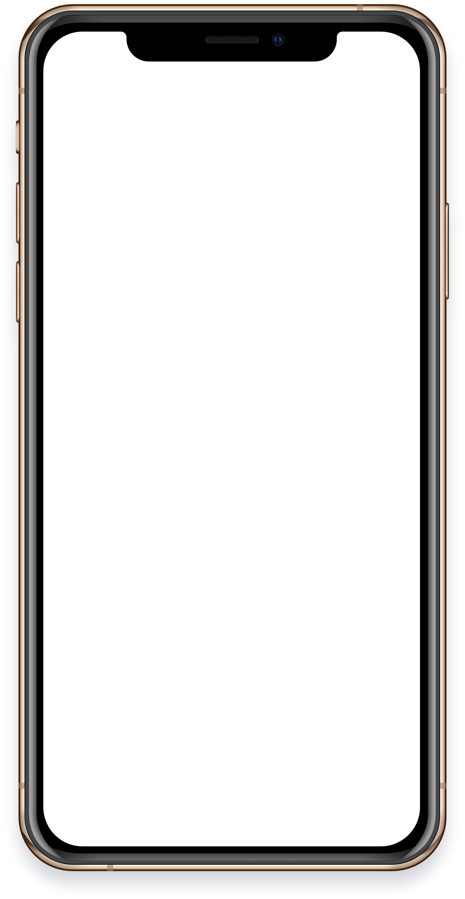
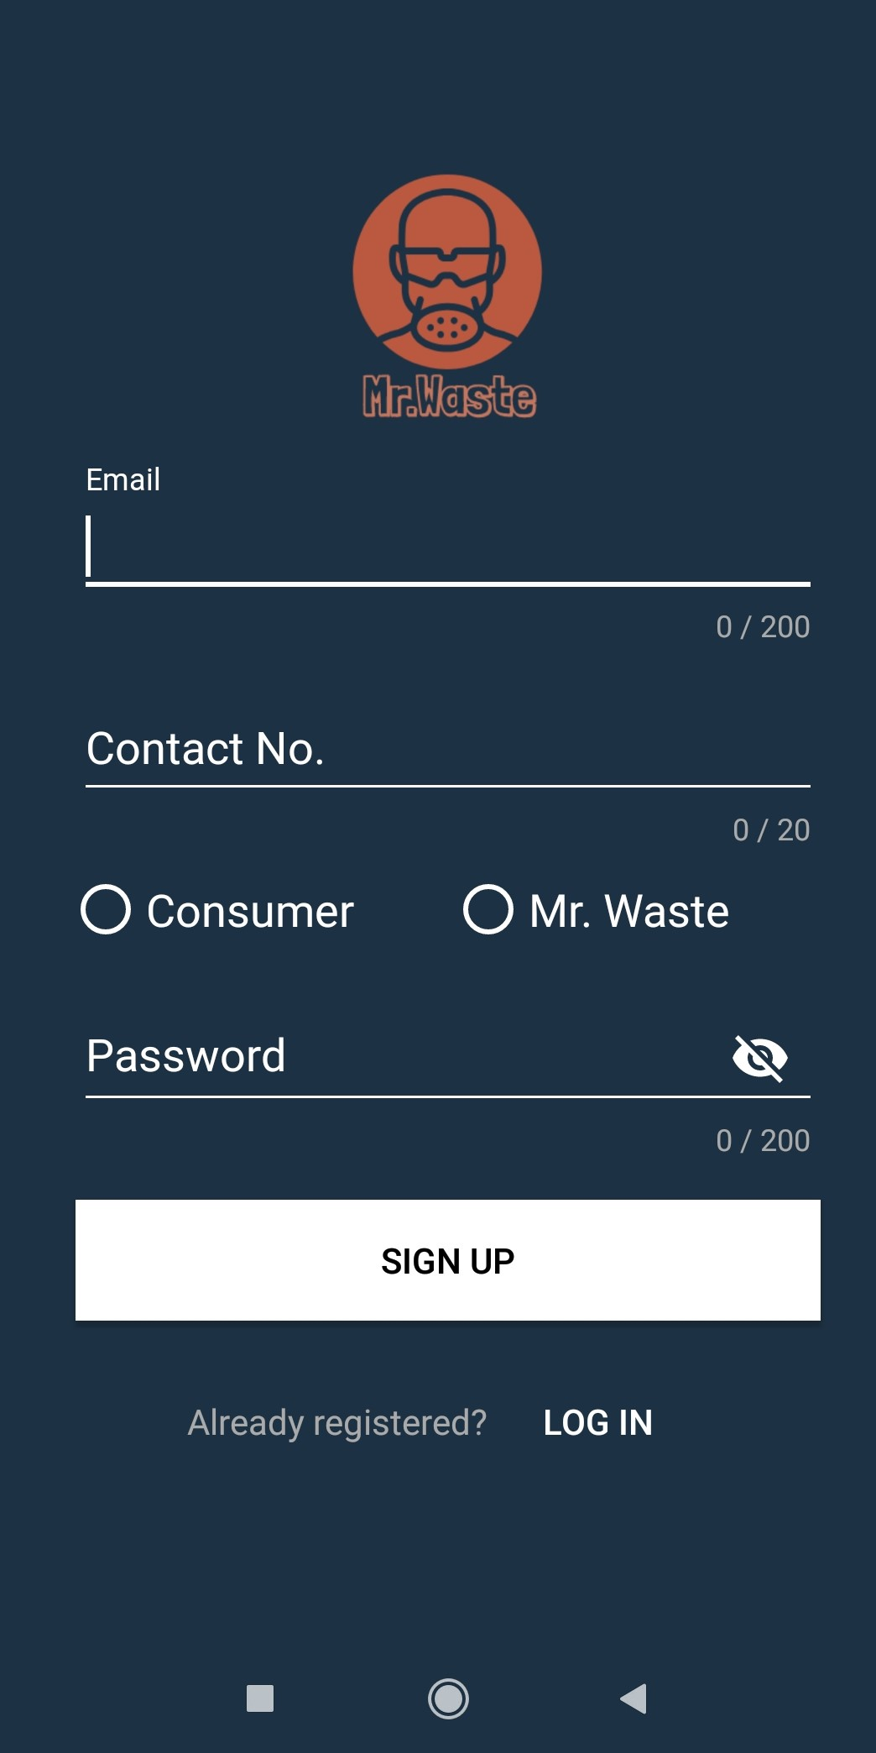
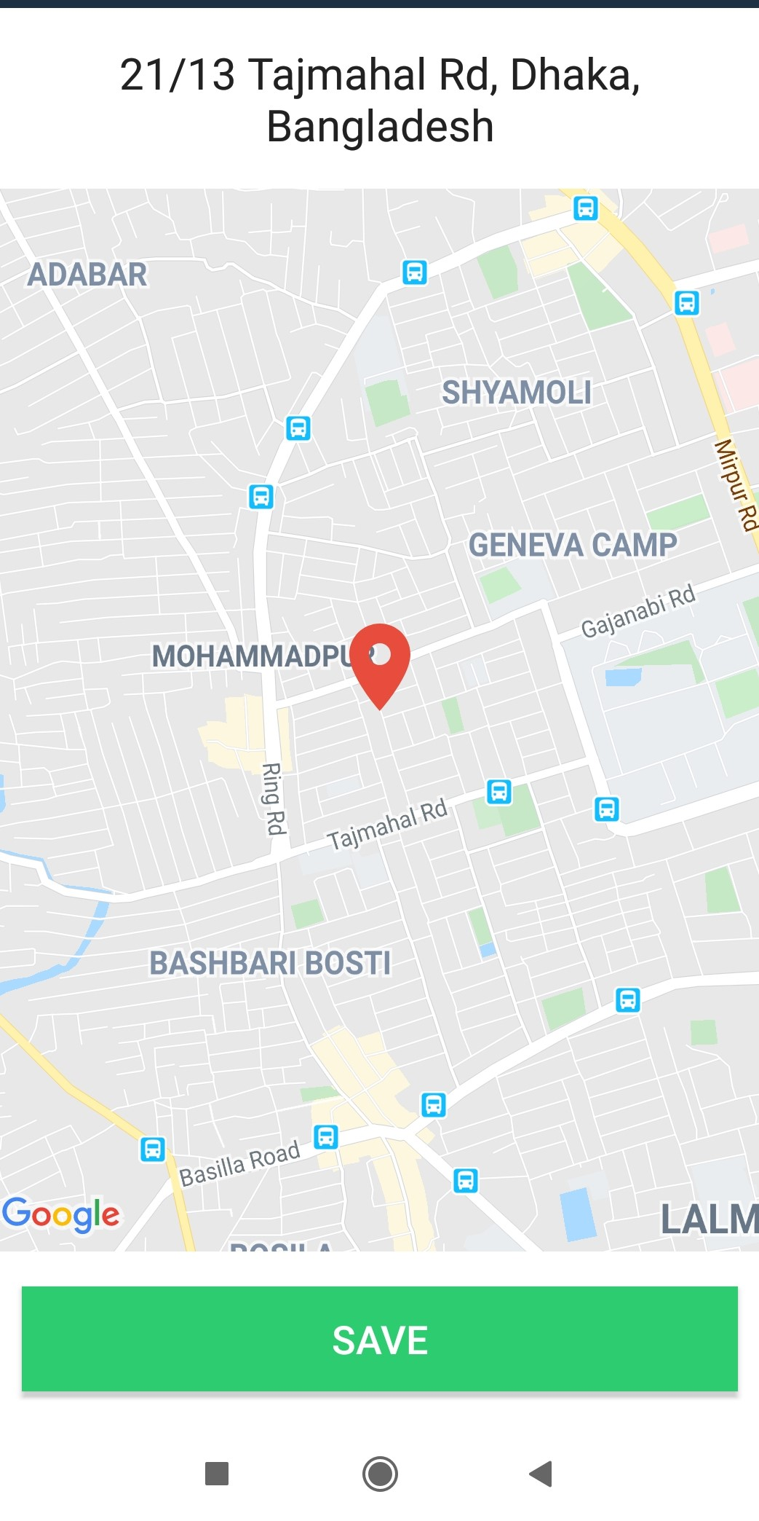
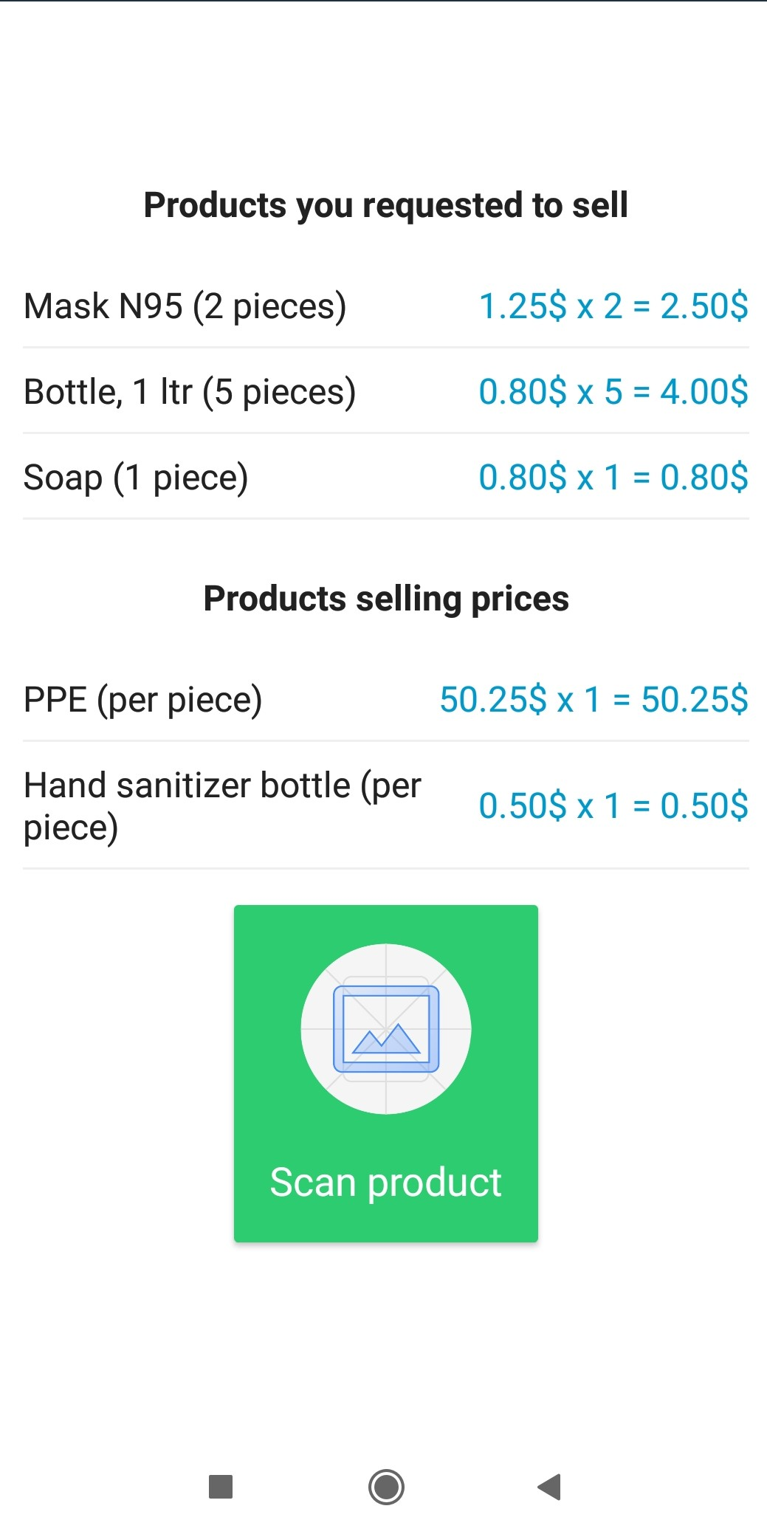
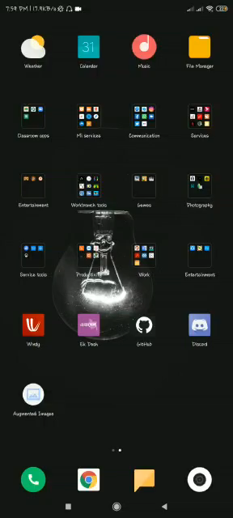



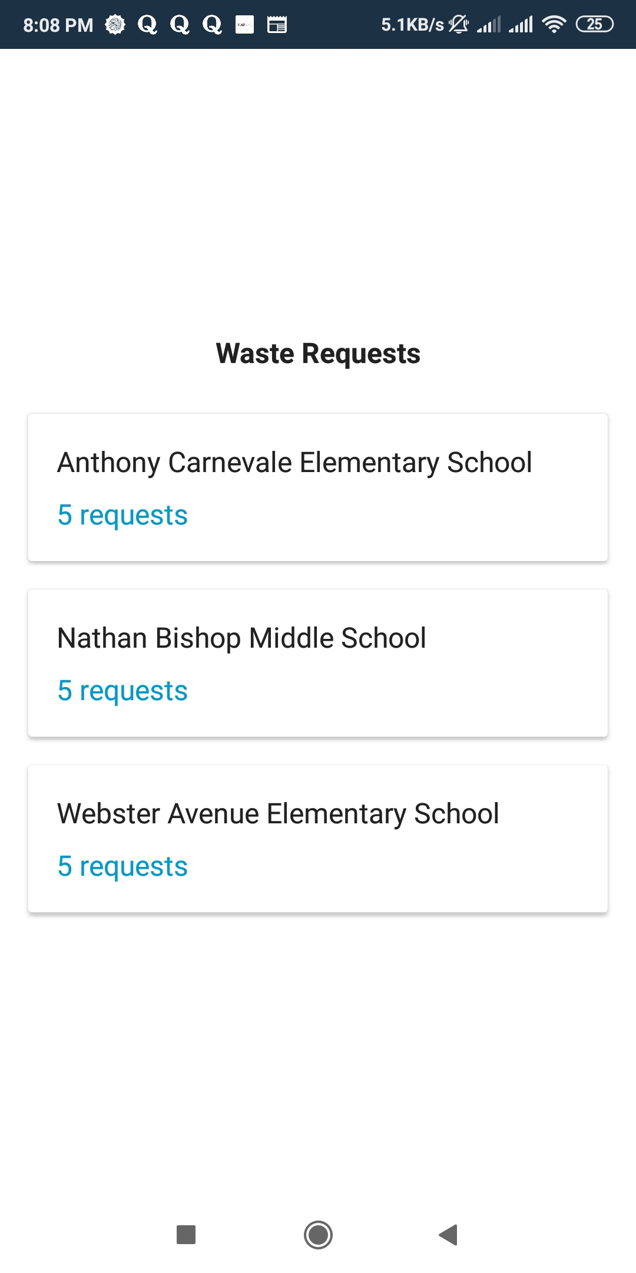
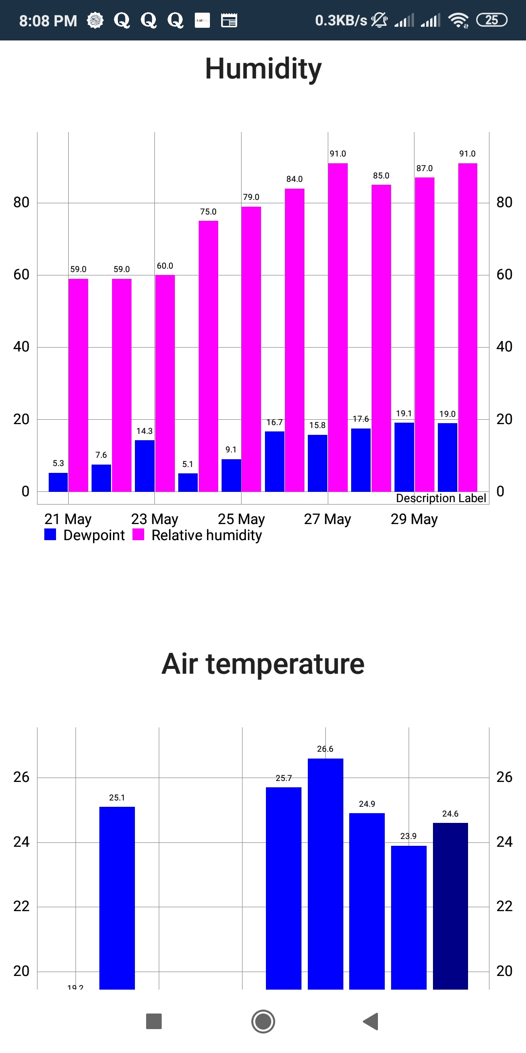


How it works
Using AR you can scan your product and
If you are a
the app will show you the amount you can get. Here is the video
Mr. Waste will go that area after knowing the condition of that area with the help of Nasa’s data
If you are

Slide 5







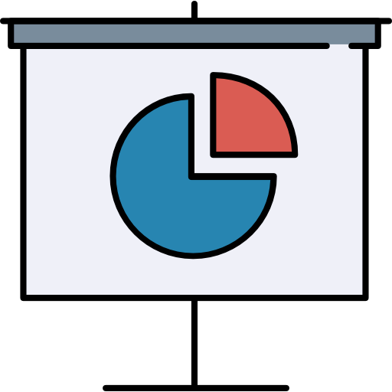


Mission
Scope
List out the used material. This scan maintains with AR (Augmented Reality)
Research
6
7
finding problem act solutions
Launch
Design
go time!
2
3
layout, graph plotting with Nasa’s data
After this pandemic this process will continue with all type of wastes
4
5
Present
Review
Operating Mr. Waste (App & website)
approve design for app and website that can save our current pollution
platform for lower income people, save the nature during lockdown condition
1
Strategize
discuss goal

